Slide 1
Evaluation and Prediction of
Cell Phone Sales
Based on Various Techniques
Lingwei Cao, Cheng Qian, Zhaoyang Tian
Tsinghua High School
Advisor: Hao Wu, Dianjun Wang

Slide 2
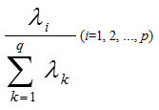
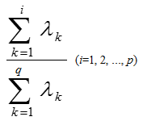



Principal Component Analysis
Principal Component Analysis (PCA) processes the data again, reduces parameters and retains the original data information as much as possible.
Using formulas above to standardize data, calculating eigenvectors and total contribution rates of PCA. The first 14 principal components (whose contribution rate over 80%) were selected.
$$z_{1}=a_{11}x_{1}+a_{21}x_{2}+a_{31}x_{3}+a_{41}x_{4}+a_{51}x_{5}+…+a_{26 1}x_{26}$$
$$z_{2}=a_{12}x_{1}+a_{22}x_{2}+a_{32}x_{3}+a_{42}x_{4}+a_{52}x_{5}+…+a_{26 2}x_{26}$$
$$…$$
$$z_{14}=a_{1 14}x_{1}+a_{2 14}x_{2}+a_{3 14}x_{3}+a_{4 14}x_{4}+a_{5 14}x_{5}+…+a_{26 14}x_{26}$$

Slide 3
04
Modeling
Qualitative conclusion and in-depth analysis

Slide 4

Weight Determination Technique
Target Layer (RAM)
P₁
P₂
P₃
Scheme Layer(Click Rate)
C₁
C₂
C₃
C₄
C₅
$$Aw=λw$$
Among phones with middle display resolution, both phones with higher click rate and lower click rate takes a large proportion.
Losgistic Regression
Click Rate | Convert Rate
0.115124 | 0.162528
KNN Algorithm

Slide 5
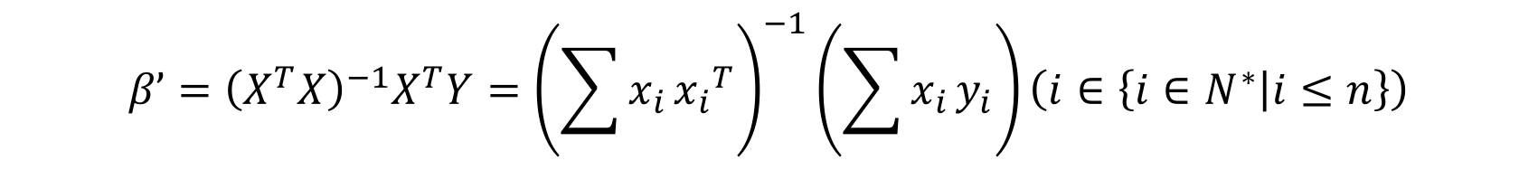
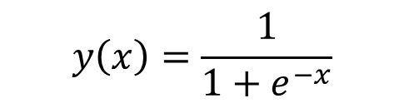

Losgistic Regression
$$y_{n}=β_{0}+β_{1}x_{1}+β_{2}x_{2}+β_{3}x_{3}+β_{4}x_{4}+β_{5}x_{5}+β_{6}x_{6}\left(n∈\left\{1,2\right\}\right)$$
$$β’={\left(X^{T}X\right)}^{−1}X^{T}Y={\left(\sum{x_{i}}{x_{i}}^{T}\right)}^{−1}\left(\sum{x_{i}}y_{i}\right)\left(i∈\left\{i∈N^{∗} | i≤n\right\}\right)$$
$$P\left\{{\hat{θ}}_{1}<θ<{\hat{θ}}_{2}\right\}=1−α$$
$$P\left\{{\hat{β}}_{n 1}<β<{\hat{β}}_{n 2}\right\}=1−α \left(n∈\left\{n∈N^{∗} | n≤2\right\}\right)$$
$$y\left(x\right)=\frac{1}{1+e^{−x}}$$

Slide 6
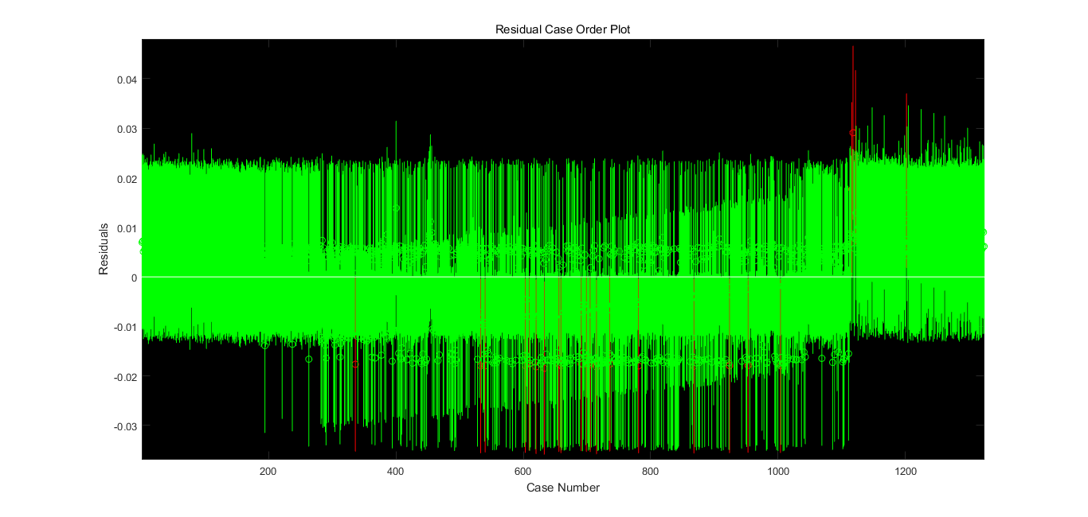
Losgistic Regression
Not much Outliers.

Slide 7
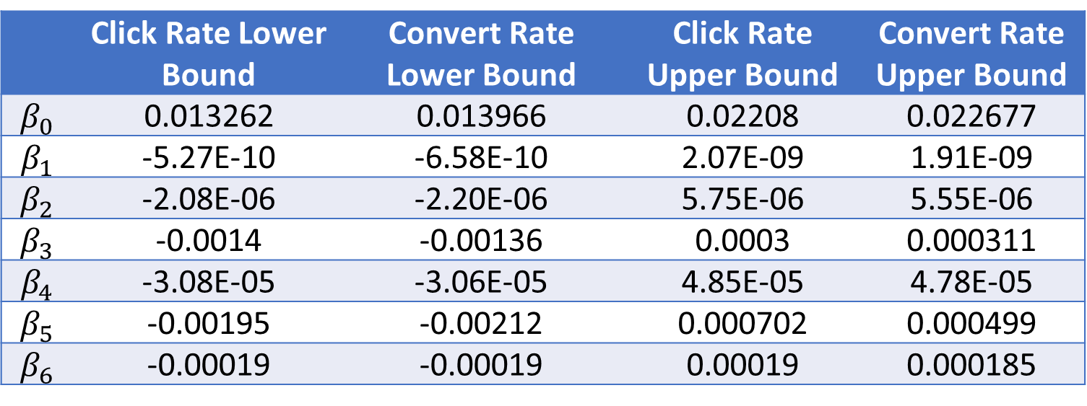
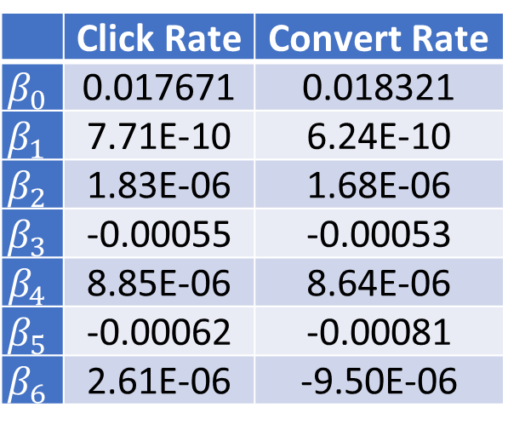
 | Click Rate | Convert Rate
$$β_{0}$$ | 0.017671 | 0.018321
$$β_{1}$$ | 7.71E-10 | 6.24E-10
$$β_{2}$$ | 1.83E-06 | 1.68E-06
$$β_{3}$$ | -0.00055 | -0.00053
$$β_{4}$$ | 8.85E-06 | 8.64E-06
$$β_{5}$$ | -0.00062 | -0.00081
$$β_{6}$$ | 2.61E-06 | -9.50E-06
Losgistic Regression
The low correlation coefficients in Logistic Regression is insufficient to reveal the features of each variable precisely.
Click Rate | Convert Rate
0.115124 | 0.162528
 | Click Rate Lower Bound | Convert Rate Lower Bound | Click Rate Upper Bound | Convert Rate Upper Bound
$$β_{0}$$ | 0.013262 | 0.013966 | 0.02208 | 0.022677
$$β_{1}$$ | -5.27E-10 | -6.58E-10 | 2.07E-09 | 1.91E-09
$$β_{2}$$ | -2.08E-06 | -2.20E-06 | 5.75E-06 | 5.55E-06
$$β_{3}$$ | -0.0014 | -0.00136 | 0.0003 | 0.000311
$$β_{4}$$ | -3.08E-05 | -3.06E-05 | 4.85E-05 | 4.78E-05
$$β_{5}$$ | -0.00195 | -0.00212 | 0.000702 | 0.000499
$$β_{6}$$ | -0.00019 | -0.00019 | 0.00019 | 0.000185

Slide 8
05
Optimization
Optimize the algorithms and quantitative conclusions

Slide 9
Principal Component Analysis
$${y_{n}}^{∗}=β_{1}′z_{1}+β_{2}′z_{2}+β_{3}′z_{3}+…+β_{14}′z_{14}\left(n∈\left\{n∈N^{∗} | n≤2\right\}\right)$$
$$y_{n}=β_{0}+β_{1}x_{1}+β_{2}x_{2}+β_{3}x_{3}+…+β_{26}x_{26}\left(n∈\left\{1,2\right\}\right)$$
Click Rate | Convert Rate
0.805032 | 0.826614

Slide 10
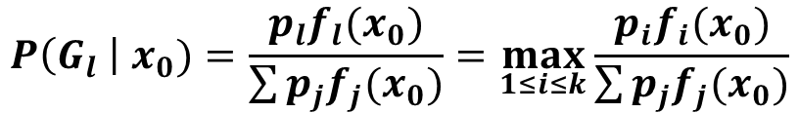
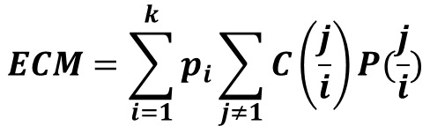
Bayes Distinction
 | High sales | Low sales
High display resolution | 7 | 1
Low display resolution | 3 | 9
$$P\left(G_{l} \right| x_{0})=\frac{p_{l}f_{l}(x_{0})}{\sum{p_{j}f_{j}(x_{0})}}=\max_{1≤i≤k}{\frac{p_{i}f_{i}(x_{0})}{\sum{p_{j}f_{j}(x_{0})}}}$$
$$ECM=\sum_{i=1}^{k}{p_{i}\sum_{j≠1}{C\left(\frac{j}{i}\right)P(\frac{j}{i})}}$$

Slide 11
Bayes Distinction
RAM to Click rate (the smaller the category is, the lower the click rate is)
 | Category 1 | Category 2 | Category 3 | Category 4
0.125 | 2 | 0 | 0 | 0
0.5 | 7 | 0 | 0 | 1
1 | 49 | 0 | 1 | 7
1.5 | 1 | 0 | 0 | 0
2 | 91 | 0 | 15 | 25
3 | 41 | 1 | 64 | 19
4 | 1 | 13 | 68 | 2
6 | 0 | 11 | 22 | 0
8 | 0 | 0 | 1 | 0
Phones with higher display resolution are apt to reveal more satisfactory sales condition. Phones with middle RAM may experience low sales or high sales.

Slide 12
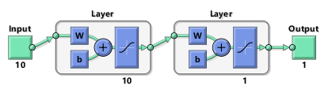
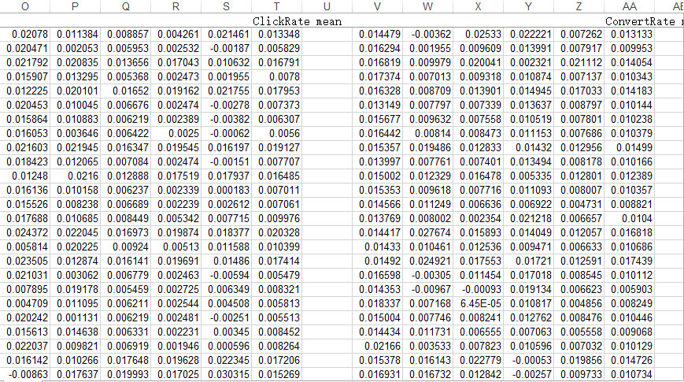
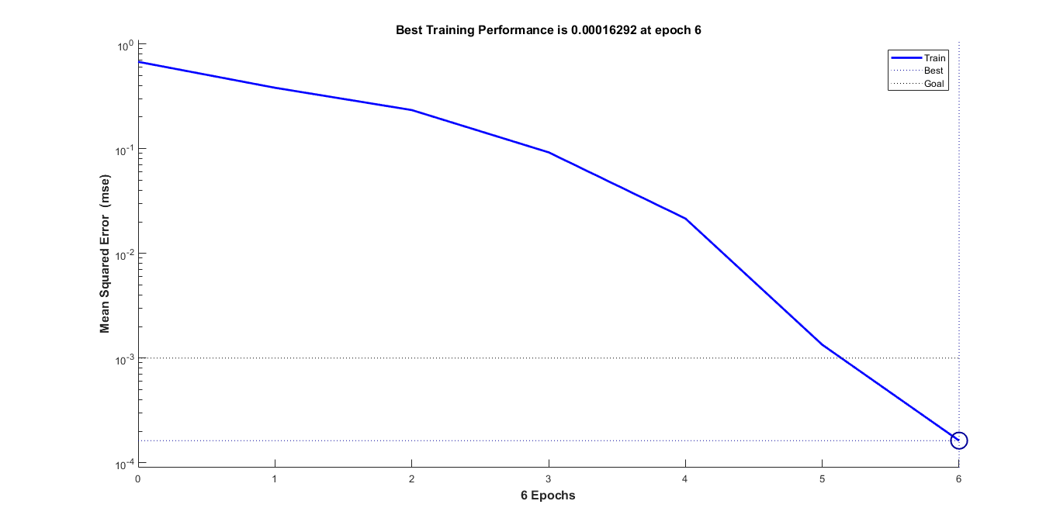
BP Neural Network
Model with 10 layers do not consume too much time, while it has a better performance. The error is decreasing rapidly. The error of some data in the table lower than 1%.

Slide 13
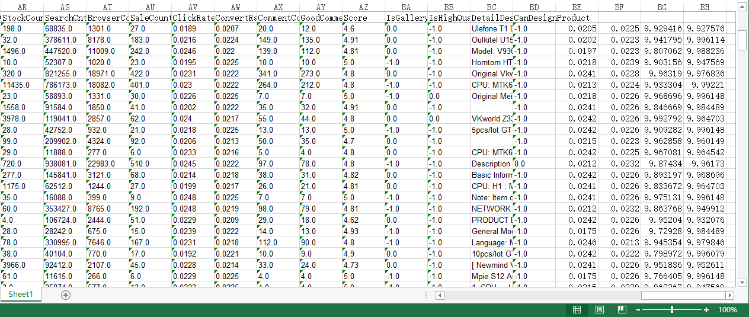
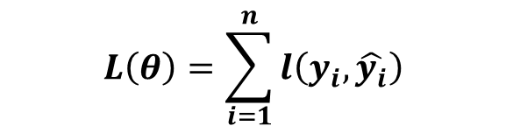
Age | Monthly shopping Amount | Usually asking or answering on Quora
14 | Less than 1000 yuan | Asking
16 | Less than 1000 yuan | Answering
24 | More than 1000 yuan | Asking
26 | More than 1000 yuan | Answering
XGBoosting Algorithm
$$L\left(θ\right)=\sum_{i=1}^{n}{l\left(y_{i},\hat{y_{i}}\right)}$$
Combining several weak classifier into a strong classifier through minimizing loss function and error.

Slide 14
Thanks for your Listening!
Lingwei Cao, Cheng Qian, Zhaoyang Tian
Tsinghua High School
Advisor: Hao Wu, Dianjun Wang

